Slide 1
Cloud Computing

Slide 2
What is Cloud Computing?
In cloud computing, The term Cloud refers to a Network or Internet ,so the phrase cloud computing means services such as servers are delivered to an organizations
Computers and devices through the internet.
Cloud Computing is both a combination of software and hardware based computing resources delivered as a network service.

Slide 3
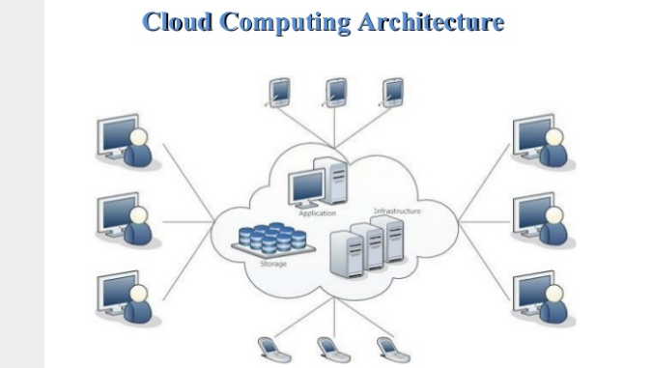

Slide 4
Features
On demand self service
Broad network access
Resource pooling
Measured service
Multi tenacity

Slide 5
Deployment Models
Deployment models define the type of access to the cloud, i.e, how the cloud is located? Cloud can have any of the four types of access: Public,private,Hybrid and Community.

Slide 6
PUBLIC CLOUD:
The public cloud allows systems and services to be easily accessible to the general public. Public cloud may be less secure because of its openness e.g google drive

Slide 7
PRIVATE CLOUD:
The private cloud allows system and services to be accessible within an organization. It offers increased security because of its private nature.

Slide 8
COMMUNITY CLOUD:
The community cloud allows systems and services to be accessible by group of organizations. More secure than public cloud.

Slide 9
HYBRID CLOUD:
The hybrid cloud is mixture of public and private cloud. However , the critical activities are performed using private cloud while the non-critical activities are performed using public cloud.

Slide 10
Service Models:
Three basic service models.
Software as a Service(Saas). This model allows to use software applications as a service to end users. e.g Google/ microsoft.
Platform as a Service(Paas). PaaS provides the runtime environment for applications , development & deployment tools etc. e.g compiles.
Infrastructure as a Service (IaaS). IaaS provides access to fundamental resources such as physical machines, virtual machines, virtual storage, etc. e.g Amazon

